Slide 1
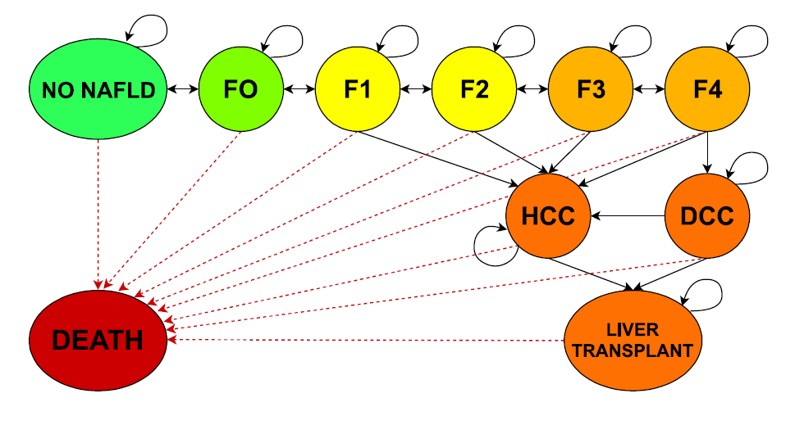
A COST-UTILITY ANALYSIS OF TREATMENTS FOR NAFLD WITH FIBROSIS
A Markov model for modeling the progression of NASH through fibrosis and its associated costs
Poornima Subramanian, PharmD Candidate. Jerome Schentag, PharmD. University of Buffalo School of Pharmacy and Pharmaceutical Sciences, Buffalo, NY
Introduction
The treatment of nonalcoholic fatty liver disease (NAFLD) and nonalcoholic steatohepatitis (NASH) is an area of active investigation. This study presents a model for assessing the cost-effectiveness of therapies for NAFLD using modification of fibrosis progression and its association with mortality.
Model inputs
All model inputs were sourced from literature and compared to inputs used in existing Markov models of NAFLD.
Transition probabilities: were sourced from various natural history studies [1-6] and compared to values used by existing Markov models for NAFLD for concordance [7-10]
Prevalences: NAFLD prevalences by age were sourced from National Health and Nutrition Examination Survey III (NHANES III) data [11] and disease stage-specific prevalences were adapted from various studies [12-16]
Mortality: Background mortality was determined using the publicly available Human Mortality Database [17]. Relative risks of mortality for fibrosis stages 1-4 were calculated based on a quantitative systematic meta-analysis of fibrosis mortality studies [18]. High mortality events, such as DCC, HCC, and LT, were not age-adjusted and were adapted from literature [19-22].
Age-related relative risk adjustments: were introduced to modify probabilities of disease progression, regression, and death for age. Values were derived from data from NHANES III [11] and United Network of Organ Sharing data [22] and calculated by Younossi et al., 2015 [8]
Costs for each disease state: were sourced from two large retrospective cohort studies of an administrative claims databased [23, 24]
Utility values: were adapted from a studies of patient-derived survey responses [25-29].
Treatment effect: Treatment effects of bariatric surgery were derived from a retrospective cohort study of 45 NASH patients with a mean follow-up of 4.5 years [30]. Effects of obeticholic acid were derived from a 72 week randomized, clinical trial of 141 patients with NASH without cirrhosis [31].
Costs of treatment: Total medical cost of bariatric surgery was derived from a retrospective study [32]. Annual cost of treatment with obeticholic acid was sourced from actual pricing for its current approved use for treatment of primary biliary cholangitis [33], and assumed to be the same for the 25 mg dose studied in its clinical trial for NAFLD as the currently available 10 mg dose.
Results
Treatment with bariatric surgery resulted in an average 4.59 QALY gained per patient treated and a computed ICER of $4,269 per QALY. Treatment of most age cohorts <45 years resulted in lifetime cost savings. Treatment with obeticholic acid was associated with 3.55 QALY gained per patient treated and an ICER of $140,486 per QALY.
Conclusion
Bariatric surgery was cost-effective at a willingness-to-pay (WTP) threshold of <$50,000 versus no treatment for patients over a life-time horizon. Moreover, treatment with bariatric surgery of patients <45 years was a dominant strategy and resulted in lifetime cost savings. Treatment with obeticholic acid, at current pricing, was not cost effective overall or for any specific age cohort at a WTP threshold of <$50,000. The model presented is a conceptual framework for modeling the cost-effectiveness of NAFLD with fibrosis that can be adapted to the results of on-going clinical trials and to model payers’ own populations. Clinicians should consider bariatric surgery as a treatment option in patients with an indication for surgery with NAFLD fibrosis stages F1-F2, especially in patients <45 years. Ongoing clinical trials should be oriented towards quantifying the size, distribution and clinical characteristics associated with fibrosis regression due to treatment effects.
Age Cohort | Bariatric Surgery QALY gained per patient treated | Obeticholic Acid QALY gained per patient treated
20-24 | 6.94 | 4.40
25-29 | 5.68 | 3.37
30-34 | 5.59 | 3.50
35-39 | 6.46 | 4.57
40-44 | 8.79 | 7.15
45-49 | 5.49 | 4.25
50-54 | 4.29 | 3.31
55-59 | 3.91 | 3.16
60-64 | 4.12 | 3.32
65-69 | 3.88 | 3.58
70-74 | 3.46 | 3.33
75-79 | 0.02 | 0.02
All ages | 4.59 | 3.55
Model structure
A Markov model was used to assess the cost-effectiveness of treatment of NAFLD, fibrosis stages F1 and F2, with bariatric surgery or 5-years of an anti-fibrosis medication compared to no treatment. The model simulated disease progression for a cohort of 10,000 Americans, ages 19-80, over a lifetime horizon to compute quality-adjusted life years (QALY). Annual disease progression was simulated for patients in 5-year age cohorts from simple steatosis through fibrosis stages 1-4, to decompensated cirrhosis, hepatocellular carcinoma, and liver transplant. Lifetime healthcare costs were calculated based on disease progression from a payer perspective and were used to determine an incremental cost effectiveness ratio (ICER) for each treatment.
Future Directions
Results shown represent an exploratory analysis, future directions for the model include:
Translation of model to Python: for ease of editing, sensitivity analysis, and web-app development for payers to model their own populations and costs
Monte Carlo probabilistic sensitivity analysis: to conduct 10,000 microsimulations sampling within uncertainty distributions for numerous parameters. Output distributions and probability of cost-effectiveness at various willingness-to-pay thresholds can then be quantified.
Expert model validation: model structure, assumptions, and inputs will be reviewed by experts for soundness and validity.
Age Cohort | Bariatric Surgery ICER ($/QALY) | Obeticholic Acid ICER ($/QALY)
20-24 | -$1,526 | $104,129
25-29 | -$1,642 | $135,208
30-34 | -$1,199 | $131,118
35-39 | $18 | $101,633
40-44 | -$1,979 | $62,232
45-49 | $2,912 | $123,165
50-54 | $4,687 | $152,603
55-59 | $6,493 | $159,345
60-64 | $4,174 | $148,270
65-69 | $11,818 | $151,922
70-74 | $15,748 | $161,595
75-79 | $1,567,406 | $27,596,321
All ages | $4,269 | $140,487
Data Analysis
The Markov model was built in Microsoft Excel® 2016 (Microsoft Corp., Redmond, WA). Calculated values included life-years (LYs), quality-adjusted life years (QALYs), lifetime cost of care overall and per patient, lifetime costs and savings per patient treated, incremental cost-effectiveness ratios (ICERs). For both treatments, ICERS were calculated relative to no treatment. No discounting was applied for the results shown.
Effect of treatments on QALYs and ICERs by Age cohort Effects of treatments were modeled by modifying transition probabilities given relative risk of fibrosis regression (defined as regression of ≥,1 stage in fibrosis score) reported in existing literature
A Markov model for NAFLD, transition state diagram shown
References
See reference handout
School of Pharmacy and Pharmaceutical Sciences University at Buffalo, The State University of New York
pharmacy.buffalo.edu

